Slide 1
Food Microbiology- 410.674.81

Slide 2
Objectives
1. Identification of Pathogens
Methods:
Applicability; Detectability; Sensitivity
2. Food borne pathogenic bacteria

Slide 3
Foodborne Pathogens
Infections caused by microbes that contaminate the food supply are a frequent reminder of the complex food web that links us with animal, plant, and microbial populations around the world.
Food safety depends on understanding these pathways well enough to prevent them.

Slide 4
Identification of Pathogens
It may be advantageous for epidemiological purposes to identify a particular bacterial strain by serotyping, which is a useful tool to accomplish this goal.
Components in the cell envelope serves as antigens for serotyping, therefore, serotyping is based on the ability of the bacteria to agglutinate antibodies specific for those antigens.

Slide 5
Conventional methods
Rely on specific media to enumerate and isolate viable bacterial cells in food.
  Sensitive
  Inexpensive
  Both qualitative and quantitative information on the number and the nature of microorganisms present in the food sample
  Following basic steps:
    pre-enrichment
    selective enrichment
    selective plating
    biochemical screening and serological confirmation

Slide 6
Conventional methods
A complete series of tests is often required before any identification can be confirmed.
Require several days as they rely on the ability of the organisms to multiply to visible colonies.
  Culture medium preparation
  Inoculation of plates
  Colony counting makes these methods labor intensive
Regarded as the golden standard often takes days to complete the identification of viable pathogens.
Any modification that reduces the analysis time can technically be called rapid method.

Slide 7
Constraints in food analysis
Microbiological analysis of food, especially for particular pathogenic species remains a challenging tusk for virtually all assays and technologies.
Major Challenges:
Bacteria are not uniformly distributed in the food
Heterogenicity of food matrices
  Ingredients such as proteins, carbohydrates, fats, oil, chemicals, preservatives etc
  Physical form of food (powder, liquid, gel, semisolid or other forms)
  Difference in viscosity due to fats and oils, which may interfere in proper mixing.

Slide 8
Major Challenges:
  • Presence of indigenous microbes which do not cause health risk but their presence often interferes with the selective identification and isolation of specific pathogens, which are usually found in low numbers

Slide 9
Need for Rapid methods
  Effective testing of bacteria requires methods of analysis that can meet a number of challenging criterions.
  Time and sensitivity of analysis are the most important limitation related to the usefulness of microbial testing.
  The food industry require more rapid methods which are sensitive for the following reasons:
    Immediate information on the possible presence of pathogen in raw material and finished products

Slide 10
Need for Rapid methods
    Low numbers of pathogenic bacteria are often present in complex biological environment along with many other non-pathogenic organisms
    The presence of even a single pathogenic organism in the food may be a infectious dose
    For monitoring of process control, cleaning and hygienic practices during manufacture
    To reduce human errors and to save time and labor cost

Slide 11
Classifications of Rapid methods
  Modified and automated conventional methods
  Biosensor's
    Bioluminescence biosensor
    Impedimetry (electrical impedance)
    Piezoelectric biosensors
    Flow cytometry
    Solid phase cytometry
    Electronic nose

Slide 12
Classifications of Rapid methods
  Modified and automated conventional methods
  Immunological methods
  Nucleic acid based assays
    DNA hybridization
    Polymerase chain reaction
    DNA micro assay (Gene chip technology)

Slide 13
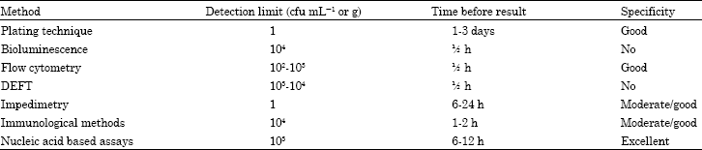
Characterization of alternative and Rapid methods

Slide 14
Plating technique
  There are several methods of adding sample homogenate to the agar plates.
  Spiral plater-
    Deposits a small volume on to the surface of the agar in a spiral fashion such that there is a dilution ratio of 10⁴ from the center to edge of the plate.
    Colonies appearing along the spiral pathway can be counted either manually or electronically.
    As the volume dispensed at any point is known, this technique eliminates the need for serial dilution before plating and less time requited for colony counting.

Slide 15
Biosensors
  Centered on four basic physiological or genetic properties of microorganisms:
    Metabolic patterns of substrate utilization
    Phenotypic expression analysis of signature molecules by antibodies
    Nucleic acid analysis
    Analysis of the interaction of pathogens with eukaryotic cells

Slide 16
Biosensors
  Many of the modern-day biosensor-based methods are developed utilizing one of the above four principles or combinations of some sort to obtain results in 24-72 h.
  Antibody-based methods are the most popular because of their versatility, convenience and relative ease in interpretation of the data.
  A majority of biosensors use antibody for capture and detection of the target analyte.

Slide 17
Bioluminescence sensors
  Bio-analytical sensors have led to the utilization of the ability of certain enzymes to emit photons as a byproduct of their reaction, known as “bioluminescence”
  Used to detect the presence and biological condition of the cells.
    Emerging technology, rapid microbiological analysis, results in a short time.

Slide 18
Bioluminescence sensors
  Two distinct areas of Bioluminescence are of use in food industry:
  ATP bioluminescence
  Bacterial bioluminescence

Slide 19
  ATP bioluminescence
  Living cells contain the molecule ATP
  This molecule may be analyzed simply using an enzyme and coenzyme complex (Luciferase- Luciferin) found in the tail of fire fly (Photinus pyralis).
  The total light output of the sample is directly proportional to the amount of ATP present and can be quantified by luminometers.
  At least 10⁴ cells are required to produce a signal.

Slide 20
  ATP bioluminescence
  This system lacks specificity, but because of rapid response time for obtaining results, this system is very suitable for on-line monitoring of HACCP programs.
  Detection limit of 1 pg ATP which is equivalent to 1000 bacterial cells.
  ATP is present in both non-microbial and microbial cells.
    To determine microbial ATP selective extraction is used. First, non-microbial ATP is extracted with non-ionic detergents and then destroyed with high levels of potato ATPase for 5 minutes. Subsequently, microbial ATP is extracted using either trichloro-acetic acid (5%) or an organic solvent (ethanol, acetone or chloroform).

Slide 21
  Bacterial bioluminescence
  Bacterial bioluminescence gene (lux) has been identified and cloned.
  The DNA carrying this gene can be introduced into host specific phages. These phages do not posses the intracellular biochemistry necessary to express this gene, hence they remain dark.
  Transfer of lux gene to the host bacterium during infection results in light emission that can be easily detected by luminometers.

Slide 22
  Bacterial bioluminescence
  Detection limit:
    1 x 10² cells in 60 min.
  Specificity:
    Depends on phage specificity e.g: Bacteriophage p22 is specific for Salmonella typhimurium.

Slide 23
  Electrical impedance biosensor
  Detects microbes either directly due to production of ions from metabolic end products or indirectly from liberation of CO₂.
  Microbial metabolism usually results in an increase in both conductance and capacitance, causing a decrease in impedance.
  A bridge circuit usually measures impedance. This method is well suited for detection of bacteria in clinical samples and to monitor quality and detect specific food pathogens.

Slide 24
  Electrical impedance biosensor
  A population of microbes is provided with nutrients (non-electrolyte) like lactose and microbes may utilize that nutrient and convert it to lactic acid (ionic form) thus changing the impedance.
  This impedance is measured over a period of 20 h after inoculation in specific media.
  Due to automated instrument (Bactometer), capable of analyzing hundreds of sample at the same time.

Slide 25
  Electrical impedance biosensor
  Typically most impedance analysis of food samples can be completed in 24 h.
  Limitations:
    Not suited for testing samples with low number of microorganisms and that the food matrix may interfere with the analysis.

Slide 26
  Impedance-based biochip sensor
  Impedance is based on the changes in conductance in a medium due to the microbial breakdown of inert substrates into electrically charged ionic compounds and acidic by-products.
  Principle: All impedance-based systems measure the relative or absolute changes in conductance, impedance, or capacitance at regular intervals.
  The threshold value for the detection of target pathogens is mainly depends on initial inoculums and the physiological state of the cells.

Slide 27
  Impedance-based biochip sensor
  In media-based impedance methods, bacterial metabolism results in increased conductance and capacitance, with decreased impedance.
  Major advantage:
    System allows the detection of only the viable cells, which is the major concern in Food safety.
    The basic technical equipment required for performing impedance microbiology consists of special incubators and their culture vessels and an evaluation unit with computer, printer and appropriate software.

Slide 28
  Piezoelectric biosensors
  System is very attractive and offers a real time output, simplicity of use and cost effectiveness.
  Principle: Based on coating the surface of piezoelectric sensor with a selective binding substance for example antibodies to bacteria and then placing it in a solution containing bacteria.
  The bacteria will bind to the antibodies and the mass of the crystal will increase while the resonance frequency of oscillation will decrease proportionally.

Slide 29
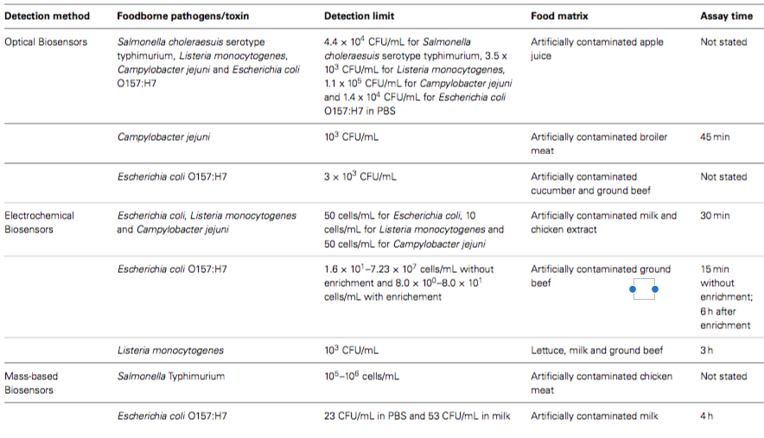
Biosensor-based methods for the detection of various foodborne pathogens in food samples

Slide 30
  FOURIER TRANSFORM INFRARED SPECTROSCOPY
  FT-IR generate bacterial spectral scans based on the molecular composition of a sample and mainly consists of the infrared source, the sample and the detector.
  It is a nondestructive rapid method and sample identification depends on the available spectral library.
  When IR is absorbed or transmitted through the sample to the detector, it generates a scan or fingerprint profile.
  A library of spectral scans can be generated for different bacterial species and strains, which can be used for future comparison.

Slide 31
  FOURIER TRANSFORM INFRARED SPECTROSCOPY
  This method requires transfer of cells (biomass) from the growth media to an IR reflecting substrate for spectral collection.
  FT-IR has been used for classification or identification of several foodborne pathogens: Yersinia, Staphylococcus, Salmonella, Listeria, Klebsiella, Escherichia, Enterobacter, Citrobacter, etc.
  FT-IR photoacoustic spectroscopy was used for the identification of spores of several Bacillus species with 100% accuracy.

Slide 32
  Immunological methods
Rely on the specific binding of an antibody to an antigen.
Immunoassay for rapid detection of microbes is due to:
  Development of new and highly sensitive essays
  Mechanical devices to automate tedious steps
  Techniques to construct predetermined antibodies of specificity (Hybridoma technology).

Slide 33
  Immunological methods
Polyclonal antibodies:
  contain a collection of antibodies having different cellular origin and therefore somewhat different specificity
Monoclonal antibodies:
  greatly enhanced the field of immunology by providing a constant and reliable source of characterized antibodies.

Slide 34
  Immunological methods
  Immunoassays can be classified as:
Homogenous immunoassay (Marker free):
  No need to separate the bound and unbound antibody; the antigen antibody complex for media is directly visible or measurable.
  Incubation times are usually very short, e.g., agglutination reaction, immunodiffusion, turbidemetry

Slide 35
  Immunological methods
Heterogeneous assays:
  Unbound antibodies must be separated from the bound antibody eg. ELISA.
  Earliest and probably the most prevalent format of antibody assay used for pathogen detection in food.
  Commercially available ELISA is usually designed as Sandwich assay.
  ELISA for pathogens have detection limits ranging from 10³-1O⁵ cfu mL⁻¹ for whole bacterial cells and few ng mL⁻¹ for toxins/protein.
  Direct detection of pathogens in food is not possible and enrichment is required for at least 16-24 h

Slide 36
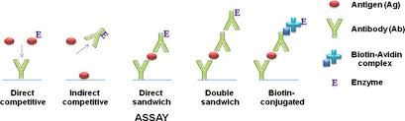
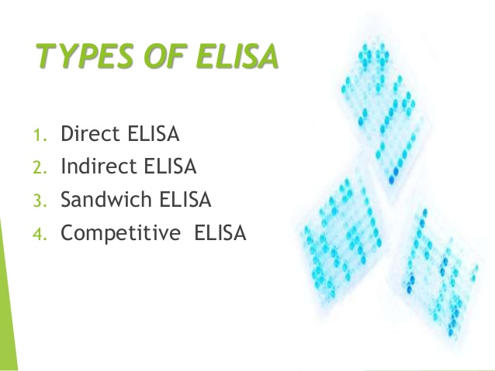
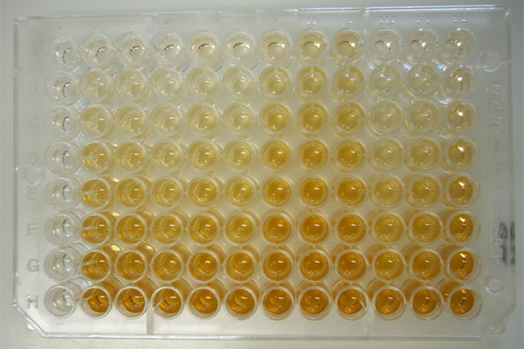

Slide 37
  Lateral flow Immunoassay
Lateral flow immunoassays such as dipstick and immunochromatographic strips have been developed for rapid on-site detection of foodborne pathogens.
Made up of four sections which are arranged orderly on a plastic backing, with sample pad starting at the bottom, followed by conjugate pad, nitrocellulose membrane and then absorbent pad.
The sample fluid migrate along the four sections of lateral flow immunoassay via capillary action.

Slide 38
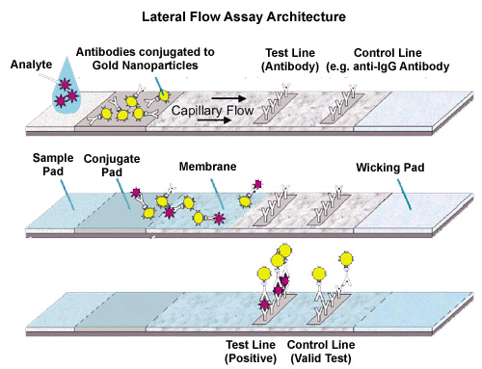
  Lateral flow Immunoassay
The sample fluid encounters and mixes with the conjugate, which can be antibody or antigen labeled by a color particle, at the conjugate pad and then pass through the lines in the nitrocellulose membrane that immobilized with antibody or antigen.
The color particle can bind to the antibody or antigen immobilized at test line depending on the analytes present in the sample.
The color can be visualized approximately two to 10 min after the addition of sample.

Slide 39
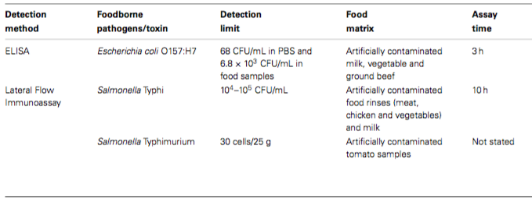
Immunological-based methods for the detection of various foodborne pathogens in food samples

Slide 40
Serotyping of pathogens with public health concern.
Serotyping of Gram-negative bacteria (examples: E. coli and Salmonella spp.) consist of the immunoreactivity of three classes of antigens:
  the O-antigen (somatic),
  H-antigen (flagellar),
  K-antigen (capsular)

Slide 41
O-antigen
  The O-antigen is a polysaccharide which is a polymer of O-subunits, composed of 4-6 sugar residues, attached to the lipid A-core polysaccharide portion of the LPS molecule.
  Differences in the immunoreactivity of antibodies (O antiserum) with the O-antigen result from the variation in the sugar components and/or covalent linkages between the O-subunit.

Slide 42
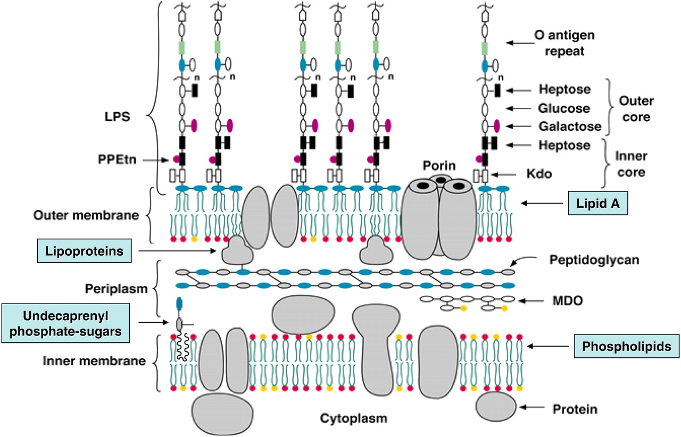
O-antigen

Slide 43
H-antigen
The H-antigen is the filamentous portion of the flagella, which is composed of protein subunits called flagellin.
The antigenically variable portion of flagellin determines the H serotype as determined by H antiserum.

Slide 44
K-antigen
K- antigens are the somatic or surface antigens that occur as envelopes, sheaths, or capsules.
They act as masking antigens for the O-antigen, inhibiting agglutination of living cell suspensions in O antiserum.

Slide 45
O- and H-antigen complex
Specific combination of O- and H-antigens defines what is known as the serotype and/or serogroups of a bacterial isolate.
The serotype and serogroups in particular species provide identifiable chromosomal markers that correlate with specific bacterial virulent clones.

Slide 46
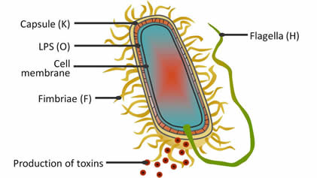
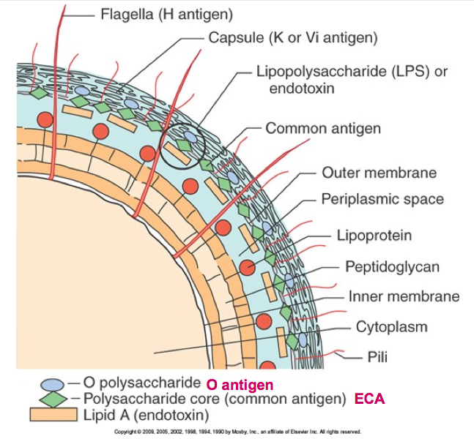
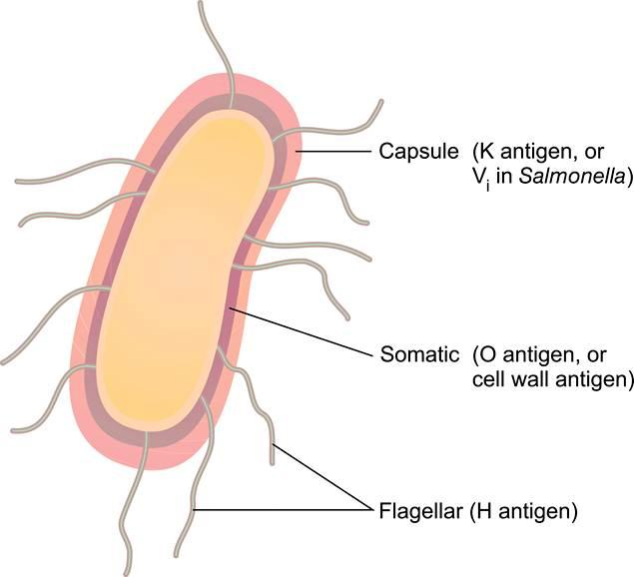
O-, H- and K- antigen

Slide 47
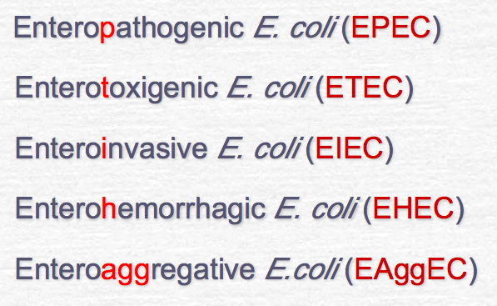
E. coli
In E. coli, a total of 170 different O-antigens and 55 H-antigens, defining the isolate serotype, have been identified; a well-known example is E. coli O157:H7 serotype, which is part of the enterohemorrhagic (EHEC) serogroup.

Slide 48
Enteropathogenic E. coli (EPEC)
Commonly associated with infant diarrhea.
Characteristic lesion with destruction of microvilli without invasion
Clinical signs:
  Fever
  Diarrhea with non-bloody stools
  Vomiting
  Nausea

Slide 49
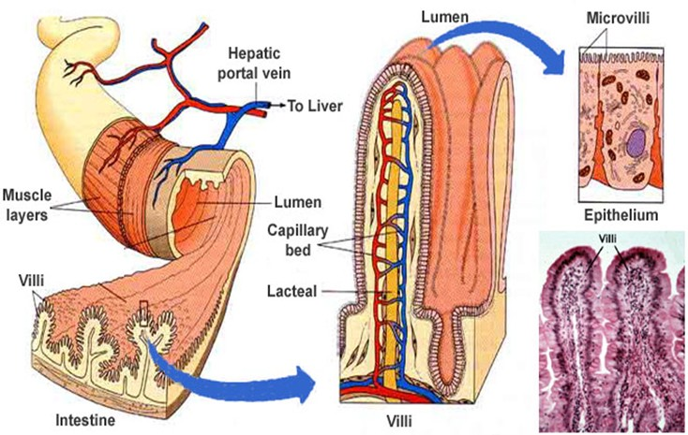

Slide 50
Enterotoxigenic E. coli (ETEC)
Cause “traveller’s diarrhea”.
Two types of plasmid-encoded toxins are produced:
  Heat labile toxins (LT), an adenyl cyclase which catalyze ATP to cAMP
  Heat stable toxins (ST), a guanyl cyclase to catalyze GTP to cGMP. cAMP/cGMP are the intracellular second massagers. The former increases the secretion of water and ions, and the latter inhibits ionic uptake.
Clinical signs:
  Watery diarrhea
  Fever
  Nausea

Slide 51
Enteroinvasive E. coli (EIEC)
Associated with elder children and adult diarrhea.
Without flagella
High virulence: a small number of EIEC can cause serious illness
Clinical signs:
  acute inflammatory responses
  tissue destruction
  diarrhea with little fluid, a lot of blood and mucus containing polymorphonuclear cells

Slide 52
Enterohemorrhagic E. coli (EHEC)
EHEC produces bacteriophage-mediated exotoxin, called as Vero toxin (VT) because of its cytotoxicity to cultured Vero cells.
In children, the disease may be progressed to a systemic stage called as hemolytic uremic syndrome (kidney injury) with 10% death rate.
Clinical signs:
  Serious abdominal pain
  diarrhea which is initially watery but then becomes bloody

Slide 53
Enteroaggregative E. coli (EAggEC)
It produces enteroaggregative heat-stable toxin (EAST) similar to the heat stable toxin of ETEC.
It produces mucous associated autoagglutinin which causes aggregation of the bacteria and formation of biofilm,
Clinical signs:
  Persistent, mucus-watery diarrhea
  Vomiting and dehydration in infants

Slide 54
Salmonella
More than 2,500 Salmonella serotypes have been described and reported.
Serotyping regarding to this species is complex due to the multiple composition of the O-antigen and these are divided into serogroups or O groups, designated by the primary O factor(s) that are associated with the group. In addition, Salmonella is unique among enteric bacteria in that it can express two different flagellin antigens, referred to as Phase 1 and Phase 2.
Examples are S. Enteritidis and S. Newport, which belong to Serogroup D and B, respectively.

Slide 55
Salmonella
Infect human (enteric fever)
  S. typhi
  S. paratyphi A
  S. schottmuelleri (S. paratyphi B)
  S. hirschfeldii
Infect animal and human
  S. choleraesuis
  S. typhimurium
  S. enteritidis

Slide 56
Serotyping of Gram-positive bacteria
Listeria monocytogenes:
  Based on the combination of somatic (O; teichoic acids) and flagellar (H) antigens.
  Serological confirmation is not necessary for regulatory identification of L. monocytogenes, it is useful for determining the prevalence of specific serotypes in epidemiological studies and for environmental recontamination tracking.
  Strains of L. monocytogenes can be assigned to 13 different serotypes, based on their combination of O- and H-antigens.
  While all of them are considered to be potentially pathogenic, most (>95%) human clinical isolates belong to three serotypes 1/2a, 1/2b, and 4b.

Slide 57
Shigella
According to the difference of O antigen, Shigella strains are divided into 4 groups:
  S. dysenteriae
  S. flexneri
  S. boydii
  S. sonnei

Slide 58
Shigella
Shigella dysenteriae can produe an exotoxin called as shiga-toxin which is similar to Vero toxin (VT) of EHEC.
Shiga-toxin is enterotoxic, cytotoxic, and neurotoxic.
The dysentery caused by this microbe is more serious than that by the other three groups.

Slide 59
  Nucleic acid based assays
Rapid analysis that used nucleic acid hybridization and nucleic acid amplification techniques offer more sensitivity and specificity than culture based methods as well as dramatic reduction in the time to get results.
Many methods have also achieved the high level automation, facilitating their application as routine sample screening assays.

Slide 60
  Nucleic acid based assays
DNA probe and PCR has been developed commercially for detecting food pathogens.
DNA based molecular typing methods:
  Pulse Field Gel Electrophoresis (PFGE)
  Restriction Fragment Length Polymorphism (RFLP)
  Ribotyping

Slide 61
  DNA HYBRIDIZATION
Based on the presence or absence of particular genes.
A gene probe is composed of nucleic acid molecules; most often double stranded DNA. (entire gene or a fragment of a gene with a known function.)
Short pieces of single stranded DNA can be synthesized, based on the nucleotide sequence of the known gene.
DNA probes must be denatured before hybridization reaction, whereas, RNA probes need not be denatured.
Gene probes can be labeled with radioactive substances by two methods: Nick translation and random priming technique.

Slide 62
  DNA HYBRIDIZATION
Oligonucleotide probes are usually labeled at 5 with 32p, using bacteriophage T4 polynucleotide kinase and gamma AT 32p.
Radioactive probes seem to have the greatest sensibility in hybridization process, they are potential hazards and disposal of radioactive wastes can be expensive.
Labeling of probes with non-radioactive substances such as alkaline phosphatase have been used without effecting the kinetics or specificity of the hybridization.

Slide 63
  POLYMERASE CHAIN REACTION
PCR is an in-vitro method used to increase number of specific DNA sequence in a sample. Increasingly used in food microbiology because of its high sensibility or specificity.
By this method, a specific DNA fragment is amplified during a cyclic 3-step process.
  The target DNA is denatured at high temperature
  Two synthetic oligonucleotides (primers) one annealed to opposite strands at a temperature that only allows hybridization to correct target
  Polymerization is performed with the oligonucleotide as primers for the enzymes and the target DNA as template

Slide 64
  POLYMERASE CHAIN REACTION
Cycles being performed over and over with namely synthesized DNA as template in addition to original target DNA, an exponential amplification of the DNA fragment between 2 primers is obtained.
PCR can amplify a single copy of DNA a million fold in less than 2 h.
In a PCR system, assuming a sensitivity of 1 cell/reaction tube, approximately 10³ bacteria mL⁻¹ sample required to ensure a reliable and repeatable amplification.

Slide 65
  Multiplex PCR (mPCR)
Basic principle of mPCR is similar to conventional PCR. However, several sets of specific primers are used in mPCR assay whereas only one set of specific primers are used in conventional PCR assay.

Slide 66
  Real-Time or Quantitative PCR (qPCR)
Different from simple PCR whereby it does not require agarose gel electrophoresis for the detection of PCR products.
This method is able to monitor the PCR products formation continuously in the entire reaction by measuring the fluorescent signal produced by specific dual- labeled probes or intercalating dyes.
The fluorescence intensity is proportional to the amount of PCR amplicons.

Slide 67
NUCLEIC ACID SEQUENCE-BASED AMPLIFICATION (NASBA)
Operates by amplifying nucleic acids under isothermal conditions.
NASBA is normally used for the amplification of RNA whereby the single- stranded RNA template is converted into complementary DNA (cDNA) by the reverse transcriptase during the reaction.
Reaction occurs at around 41◦C, involving two specific primers and three enzymes:
    avian myeloblastosis virus (AMV) reverse transcriptase
    T7 RNA polymerase
    RNase H
    The NASBA amplicons can be detected by agarose gel electrophoresis

Slide 68
LOOP-MEDIATED ISOTHERMAL AMPLIFICATION (LAMP)
LAMP is based on auto-cycling strand displacement DNA synthesis carried out by Bst DNA polymerase large fragment under isothermal conditions between 59◦C and 65◦C for 60 min.
Four primers comprising two inner primers and two outer primers are used to target six specific regions of target DNA
LAMP was used for the first time to detect stxA2 gene in Escherichia coli O157:H7.
LAMP is proven to be more specific and sensitive as compared to PCR assays for the detection of foodborne pathogens due to its rapidity and sensitivity.
Till date, commercial LAMP kits are available for the detection of Listeria, Salmonella, Campylobacter, Legionella, and verotoxin-producing Escherichia coli

Slide 69
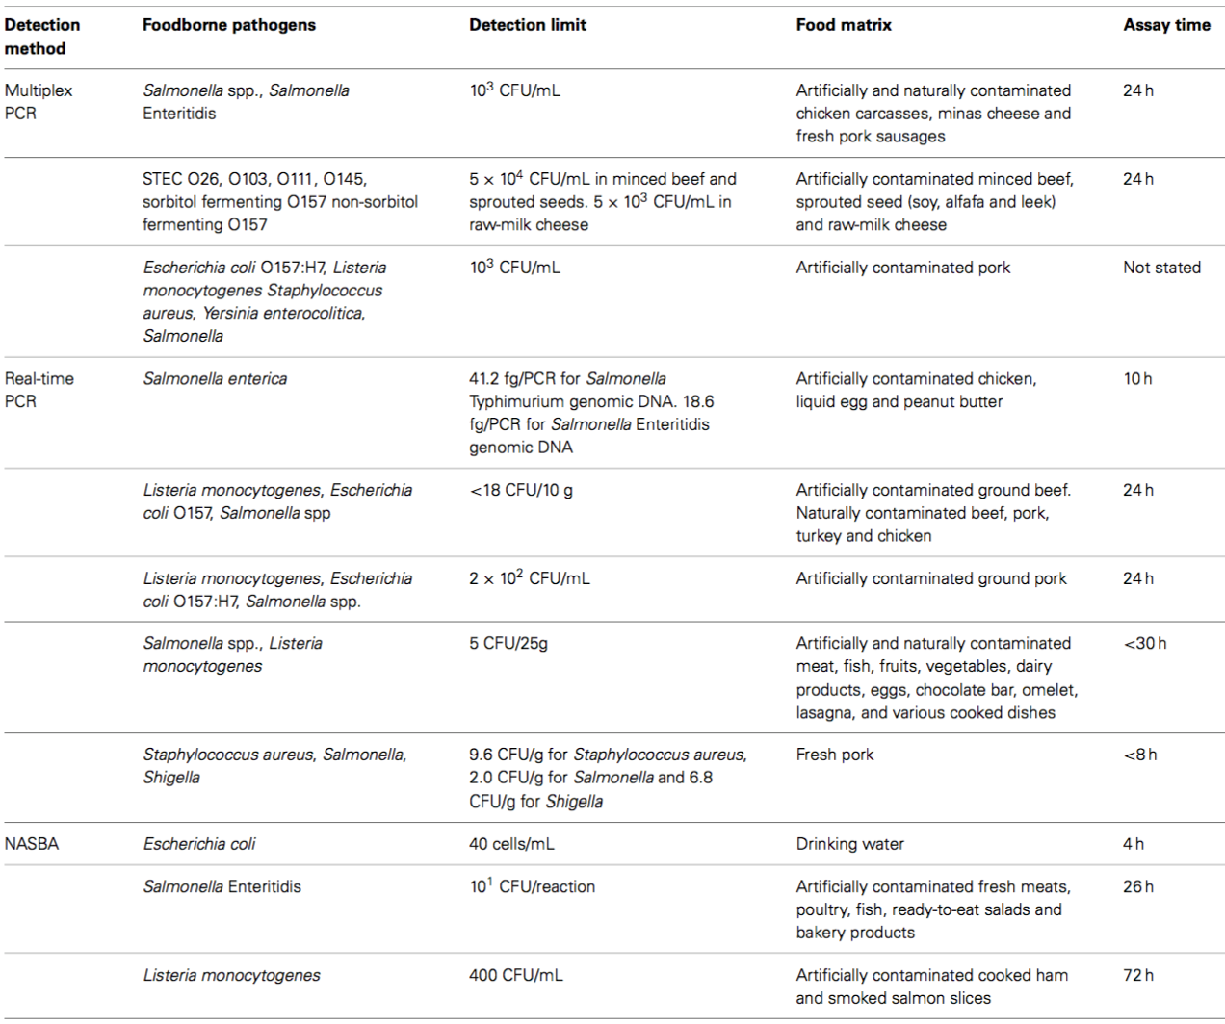
Nucleic acid –based methods for the detection of various foodborne pathogens in food samples

Slide 70
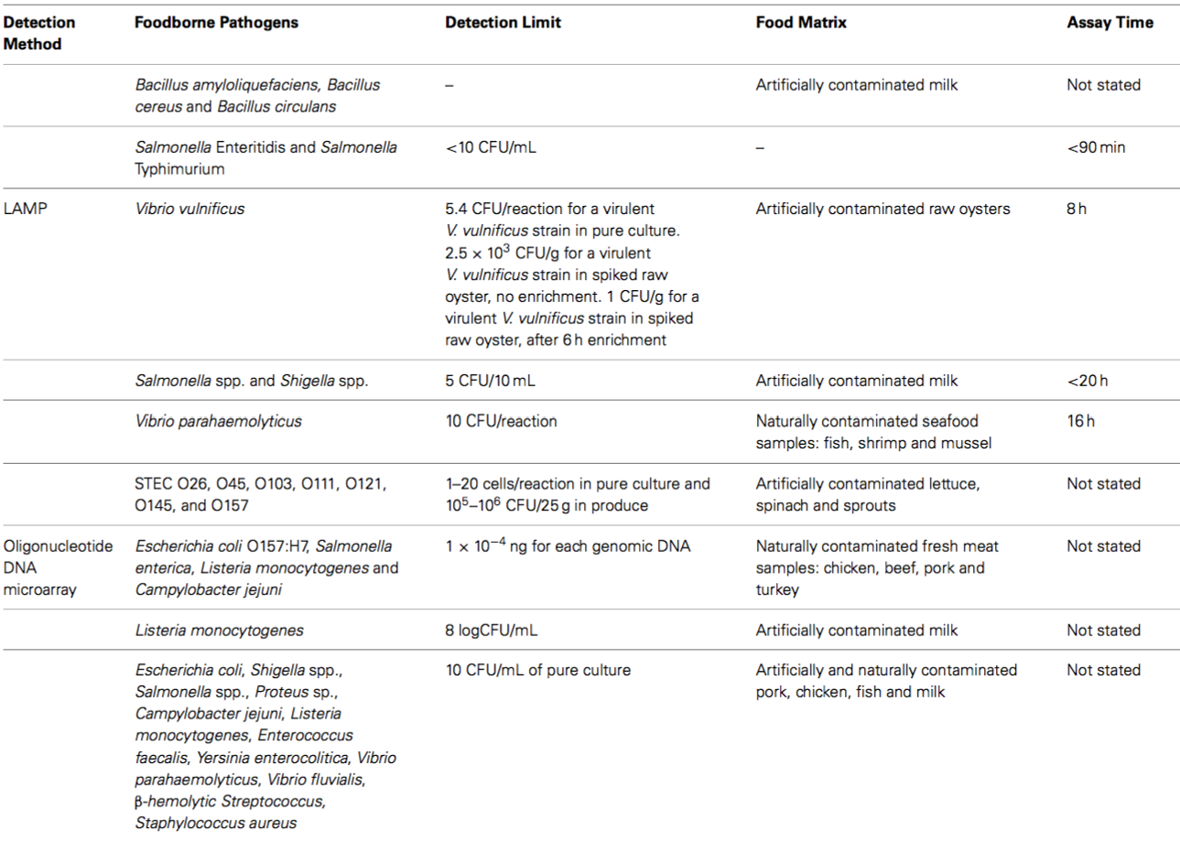

Slide 71
  DNA MICROARRAYS
  (GENE CHIP TECHNOLOGY)
Based on photolithography, which was developed by computer chip makers.
Gene chip can be made of glass or nylon membrane and there are two basic variants.
In one format, target DNA is amplified by PCR and spread on to a membrane, which is then probed either singly or simultaneously by hundreds of labeled probes to determine specific hybridization.
In other format, an array of oligonucleotides are synthesized directly on a glass chip and then exposed to labeled target DNA.

Slide 72
  DNA MICROARRAYS
  (GENE CHIP TECHNOLOGY)
DNA chip technology also makes it possible to detect diverse individual sequence in complex DNA samples.
Development of this approach is continuing at a rapid pace and for microbiologists, this technology will be one of the major tools for the future.

Slide 73
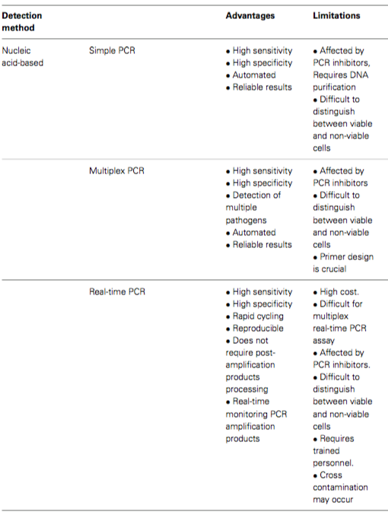
Advantages and limitations of each rapid detection methods

Slide 74
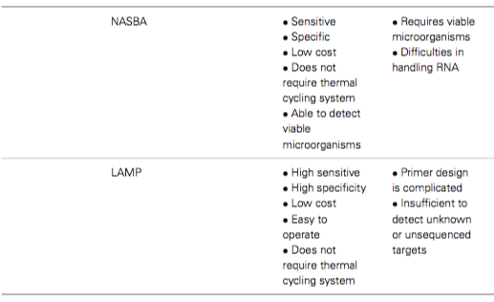
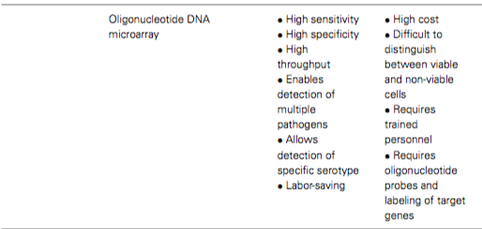
Advantages and limitations of each rapid detection methods

Slide 75
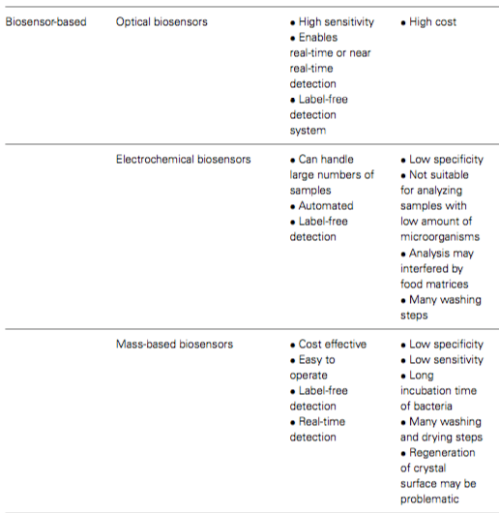
Advantages and limitations of each rapid detection methods

Slide 76
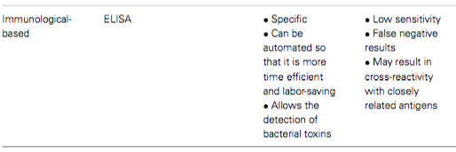
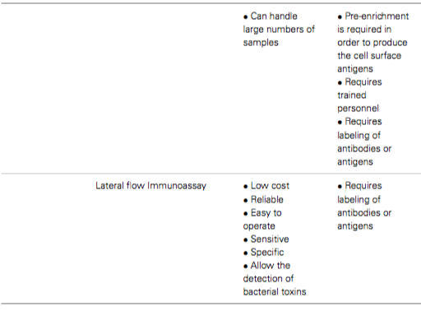
Advantages and limitations of each rapid detection methods

Slide 77
  REQUIREMENTS FOR ALTERNATIVE AND RAPID METHODS
Factors towards adoption of new method:
  Accuracy
  Validation
  Speed
  Automaton and computerization
  Sample matrix
  Costs
  Simplicity
    Reagents and supply should be rapidly available
    Training, technical service and company support is essential
    Space requirements
      Instruments are preferably compact and small

Slide 78
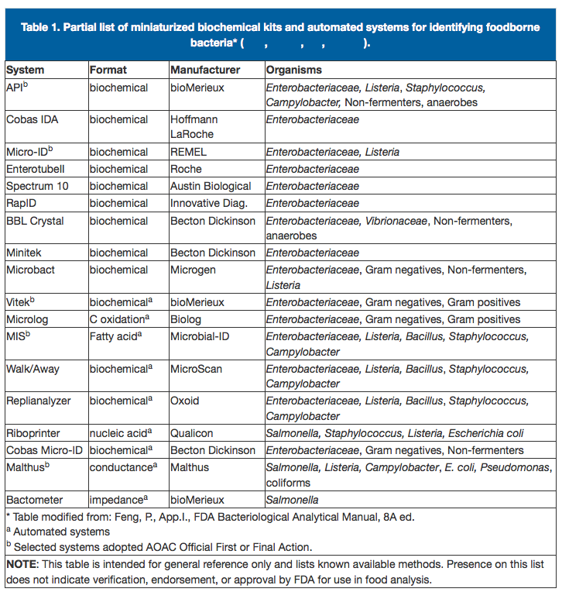
Rapid Methods for Detecting Foodborne Pathogens
Ref.: http://www.fda.gov/Food/FoodScienceResearch/LaboratoryMethods/ucm109652.htm

Slide 79
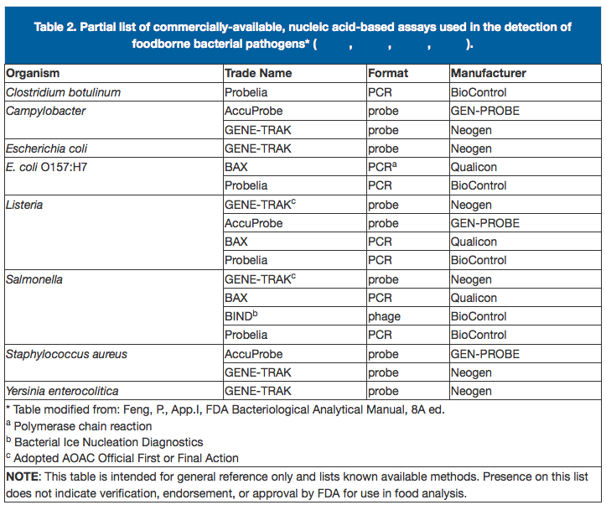
Rapid Methods for Detecting Foodborne Pathogens
Ref.: http://www.fda.gov/Food/FoodScienceResearch/LaboratoryMethods/ucm109652.htm

Slide 80
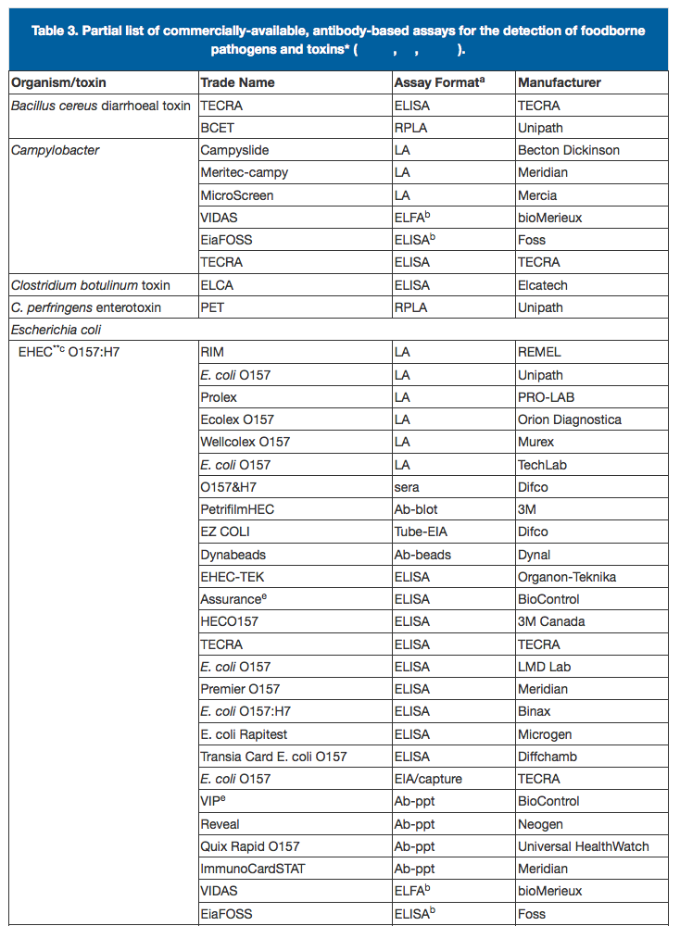
Rapid Methods for Detecting Foodborne Pathogens
Ref.: http://www.fda.gov/Food/FoodScienceResearch/LaboratoryMethods/ucm109652.htm

Slide 81
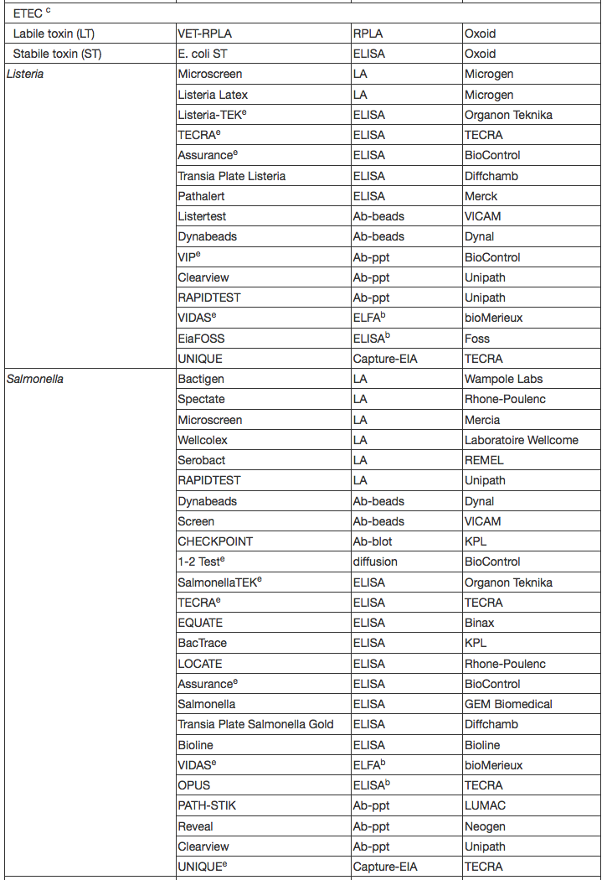
Ref.: http://www.fda.gov/Food/FoodScienceResearch/LaboratoryMethods/ucm109652.htm

Slide 82
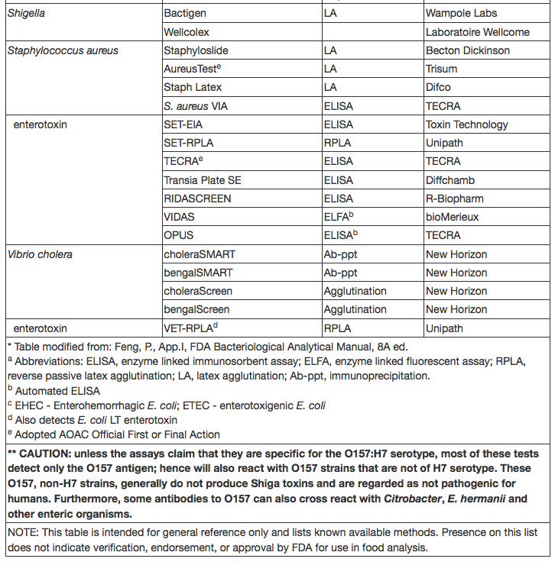
Ref.: http://www.fda.gov/Food/FoodScienceResearch/LaboratoryMethods/ucm109652.htm

Slide 83
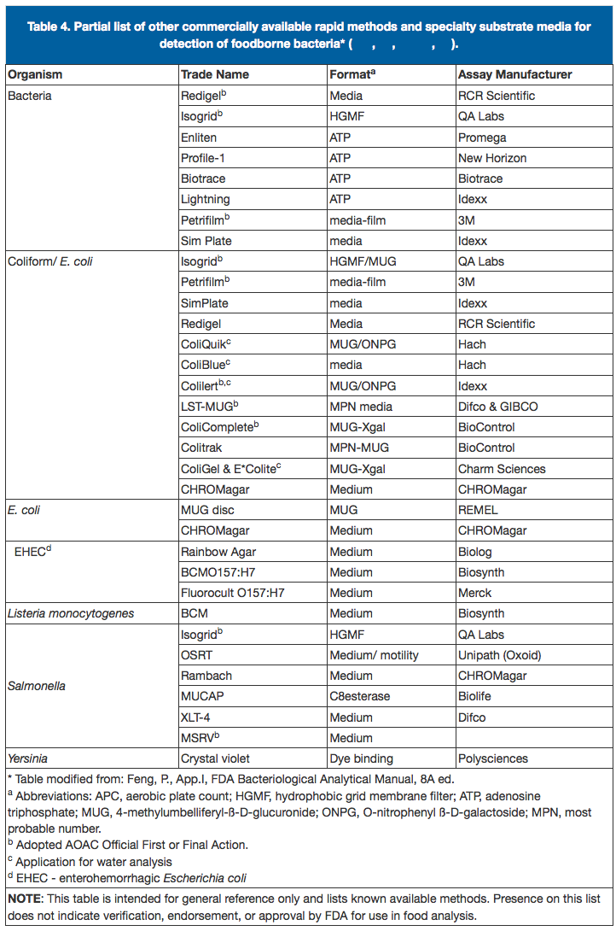
Rapid Methods for Detecting Foodborne Pathogens
Ref.: http://www.fda.gov/Food/FoodScienceResearch/LaboratoryMethods/ucm109652.htm

Slide 84
Food Testing Solutions: Thermo Scientific
Food and Beverage
http://www.thermofisher.com/us/en/home/industrial/food-beverage.html
Food Microbiology Testing
http://www.thermofisher.com/us/en/home/industrial/food-beverage/food-microbiology-testing.html

Slide 85
Food Safety Testing: BIO-RAD
Bio-Rad's PCR kits and testing automation, standard and chromogenic media, and immune sera help food science laboratories improve food safety and risk management by minimizing the time and cost of microbiological and molecular food testing and ensuring reproducible results.
Please visit following links: http://www.bio-rad.com/en-us/category/food-safety-testing
Chromogenic Media: http://www.bio-rad.com/en-us/category/chromogenic-media?pcp_loc=catprod
Serological Testing: http://www.bio-rad.com/en-us/category/serological-testing?pcp_loc=catprod
Food PCR Testing Kits:
http://www.bio-rad.com/en-us/category/food-pcr-testing-kits?pcp_loc=catprod

Slide 86
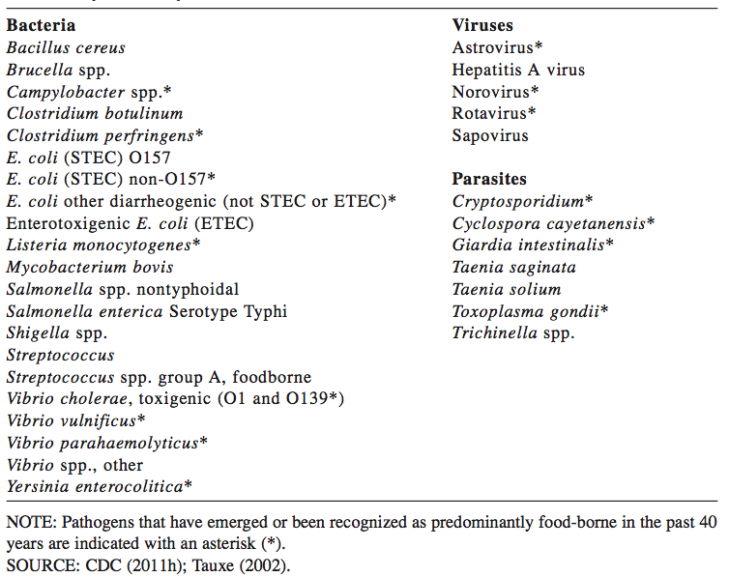
Major Food-borne pathogens in the United States
http://www.cdc.gov/foodborneburden/PDFs/pathogens-complete-list.pdf
Tauxe, R. V. 2002. Emerging foodborne pathogens. International Journal of Food Microbiology 78:31-41.

Slide 87
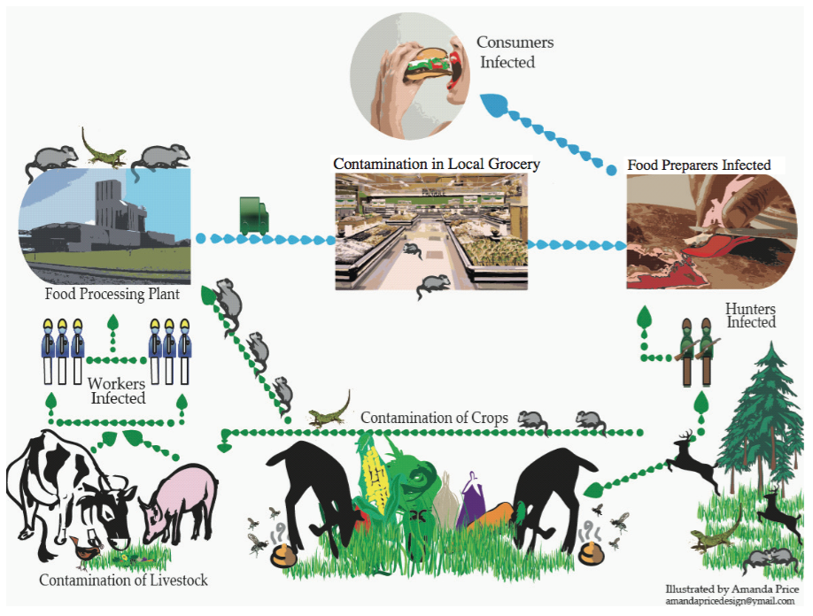
Routes of contamination resulting in food-borne illness linked to wildlife.
SOURCE: Illustrated by Amanda Price.

Slide 88
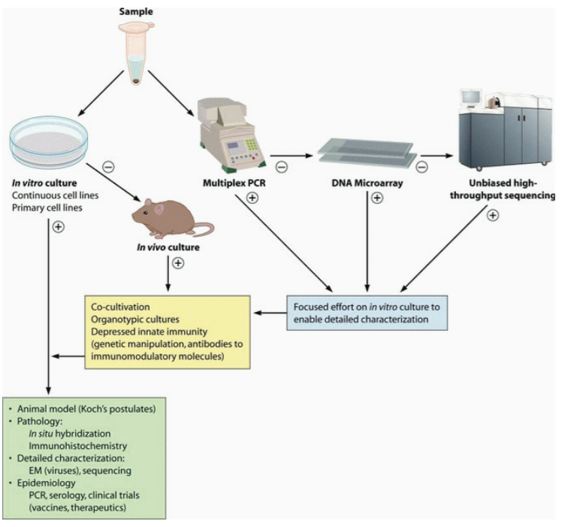
Strategies for pathogen discovery and link to causation. In the molecular era of pathogen discovery, culture and molecular methods are pursued in parallel until an agent is detected, isolated, and characterized. +, positive result; −, negative result.
SOURCE: Lipkin (2010) Copyright © American Society for Microbiology, Lipkin, W. I. (2010). Microbe Hunting. Microbiology and Molecular Biology Reviews. 74 (3):363-377: doi:10.1128/MMBR.00007-10. Reproduced with permission from American Society for Microbiology.

Slide 89
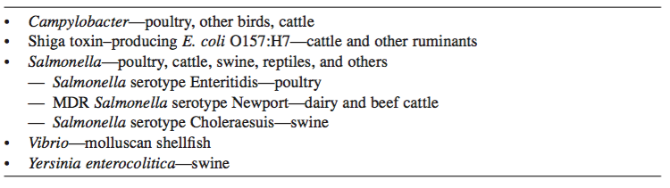
Major Food-Animal Reservoirs for Human Foodborne Bacterial Pathogens

Slide 90
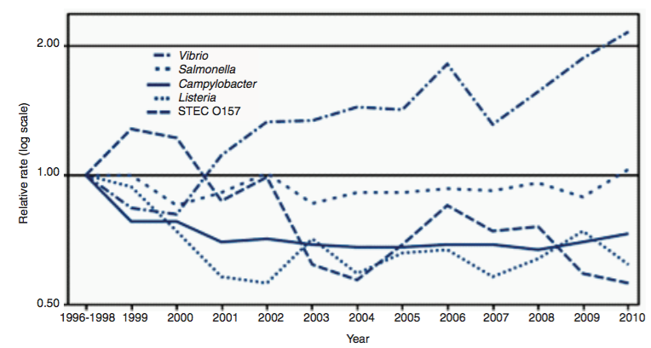
Relative rates of laboratory-confirmed infections with Campylobacter, Shiga toxin–producing Escherichia coli O157, Listeria, Salmonella, and Vibrio, compared with 1996-1998 rates, by year, in the United States during 1996-2010
Source: Data adopted from the Foodborne Diseases Active Surveillance Network (FoodNet). CDC

Slide 91
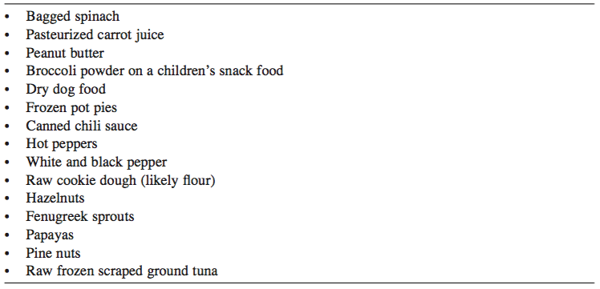
Fifteen New Food Vehicles Identified from 2006 Through March 2015 in Foodborne Outbreaks Affecting the United States
SOURCE: CDC

Slide 92
Food-Borne Diseases
Primary types
  food-borne infections
  food intoxications
  Food infections (microbes are transferred to consumer)
  Food poisoning (results from the toxin consumption)

Slide 93
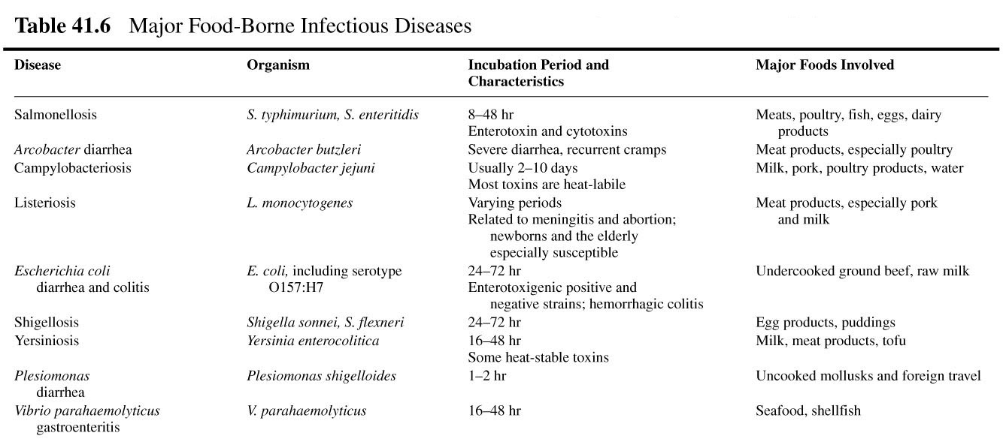
Major Food-Borne Infectious Diseases

Slide 94
Major Food-Borne Diseases
Organism | Number of cases per year (U.S.) | Foods to watch
Campylobacter jejuni | 1,963,000 | Poultry and diary products
Salmonella spp. | 1,340,000 | Poultry, meat, diary and eggs
Clostridium perfringens | 248,000 | Cooked and reheated meat products
Giardia lamblia | 200,000 | Contaminated meat
Norwalk-like viruses | 9,200,000 | Shellfish, other food

Slide 95
Food-Borne Intoxications
ingestion of toxins in foods in which microbes have grown
include staphylococcal food poisoning, botulism, Clostridium perfringens food poisoning, and Bacillus cereus food poisoning

Slide 96
Toxins
Ergotism
  toxic condition caused by growth of a fungus in grains
Aflatoxins
  carcinogens produced in fungus-infected grains and nut products
Fumonisins
  carcinogens produced in fungus-infected corn

Slide 97
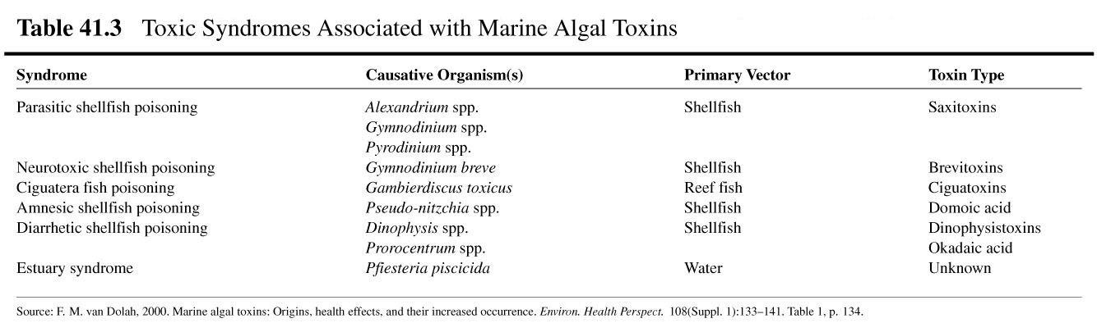
Toxic Syndromes Associated with Marine Algal Toxins

Slide 98
Least Wanted Foodborne Pathogens
Campylobacter- Second most common bacterial cause of diarrhea in the United States.
Sources: raw and undercooked poultry and other meat, raw milk and untreated water.
Clostridium botulinum- This organism produces a toxin which causes botulism, a life-threatening illness that can prevent the breathing muscles from moving air in and out of the lungs.
Sources: improperly prepared home-canned foods; honey should not be fed to children less than 12 months old.
E. coli O157:H7- A bacterium that can produce a deadly toxin and causes approximately 73,000 cases of foodborne illness each year in the U.S.
Sources: beef, especially undercooked or raw hamburger; produce; raw milk; and unpasteurized juices and ciders.

Slide 99
Listeria monocytogenes- Causes listeriosis, a serious disease for pregnant women, newborns, and adults with a weakened immune system.
Sources: unpasteurized dairy products, including soft cheeses; sliced deli meats; smoked fish; hot dogs; pate'; and deli-prepared salads (i.e. egg, ham, seafood, and chicken salads).
Norovirus- The leading viral cause of diarrhea in the United States. Poor hygiene causes Norovirus to be easily passed from person to person and from infected individuals to food items.
Sources: Any food contaminated by someone who is infected with this virus.
Salmonella- Most common bacterial cause of diarrhea in the United States, and the most common cause of foodborne deaths. Responsible for 1.4 million cases of foodborne illness a year.
Sources: raw and undercooked eggs, undercooked poultry and meat, fresh fruits and vegetables, and unpasteurized dairy products.

Slide 100
Staphylococcus aureus- This bacterium produces a toxin that causes vomiting shortly after being ingested.
Sources: cooked foods high in protein (e.g. cooked ham, salads, bakery products, dairy products) that are held too long at room temperature.
Shigella - Causes an estimated 448,000 cases of diarrhea illnesses per year. Poor hygiene causes Shigella to be easily passed from person to person and from infected individuals to food items.
Sources: salads, unclean water, and any food handled by someone who is infected with the bacterium.
Toxoplasma gondii- A parasite that causes toxoplasmosis, a very severe disease that can produce central nervous system disorders particularly mental retardation and visual impairment in children. Pregnant women and people with weakened immune systems are at higher risk.
Sources: raw or undercooked pork.
Vibrio vulnificus- Causes gastroenteritis, wound infection, and severe bloodstream infections. People with liver diseases are especially at high risk. Sources: raw or undercooked seafood, particularly shellfish.

Slide 101
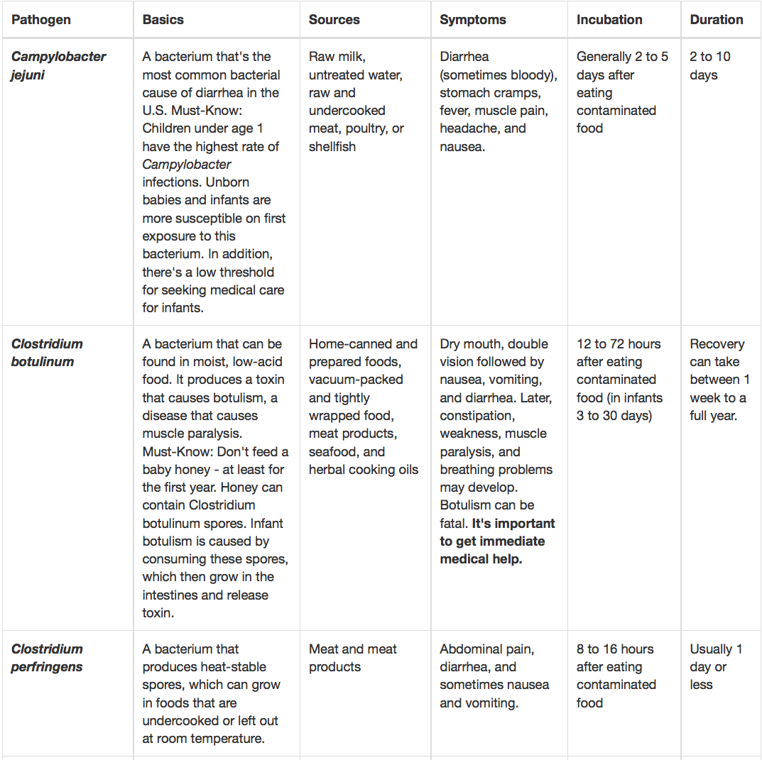
Top 14 Foodborne Pathogens
Must-know-
specifics

Slide 102
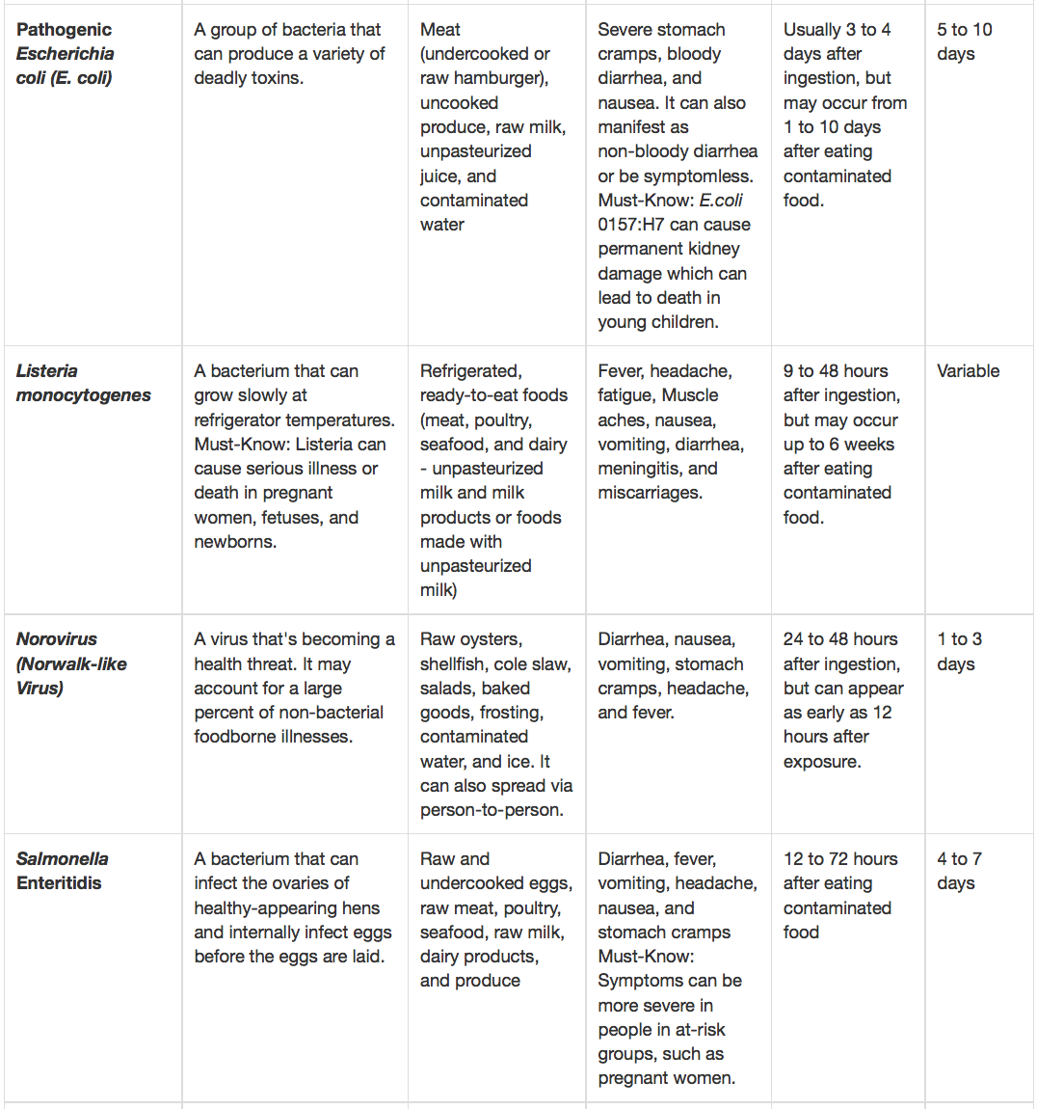

Slide 103
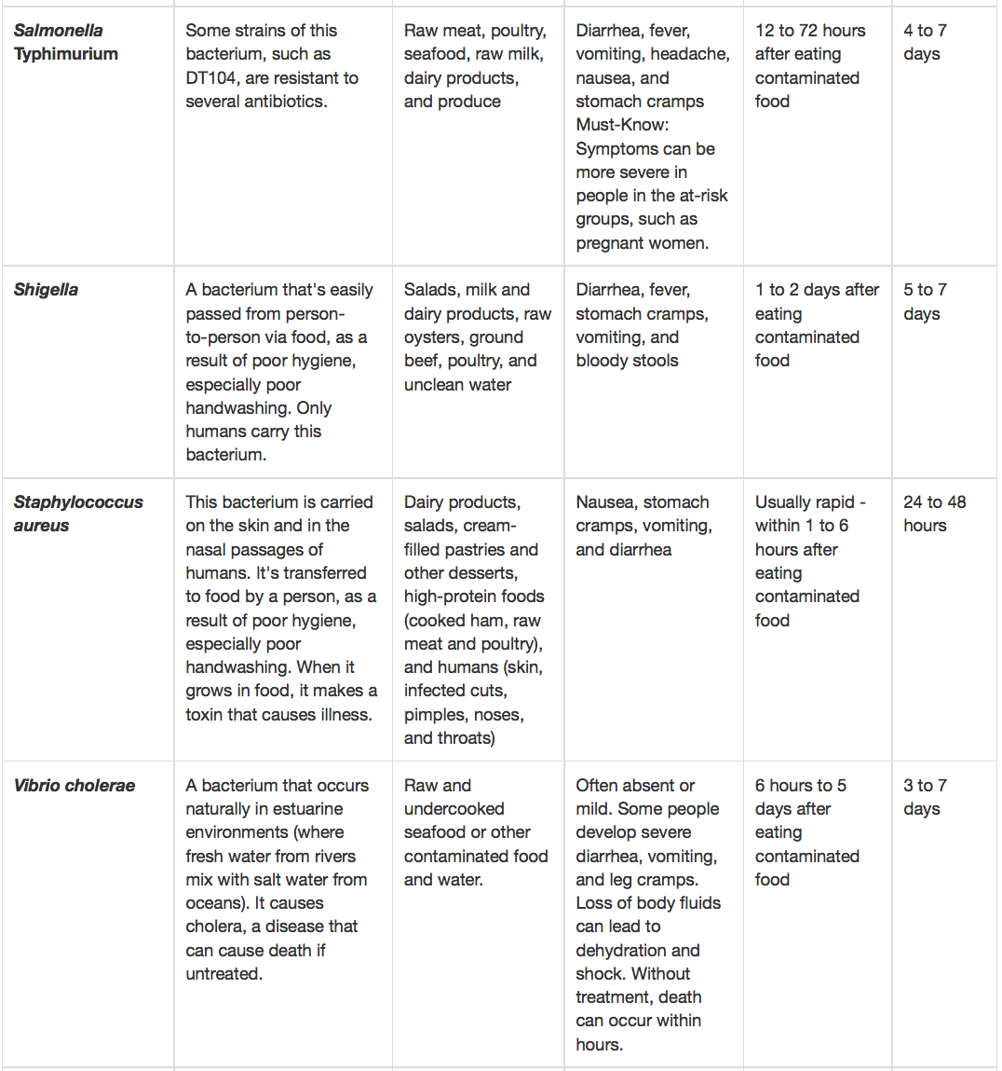

Slide 104
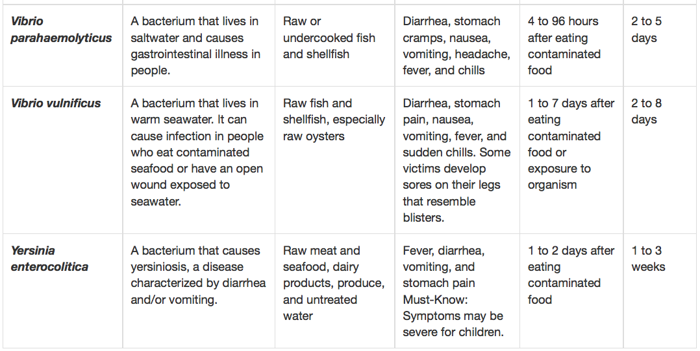
Source: http://www.fda.gov/food/resourcesforyou/healtheducators/ucm091681.htm

